Slide 1
Murmansk state regional universal scientific library

Slide 2
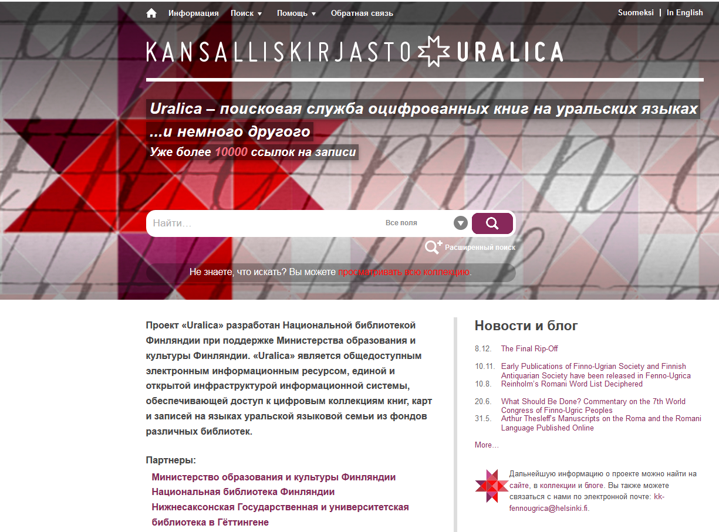
«URALICA»

Slide 3
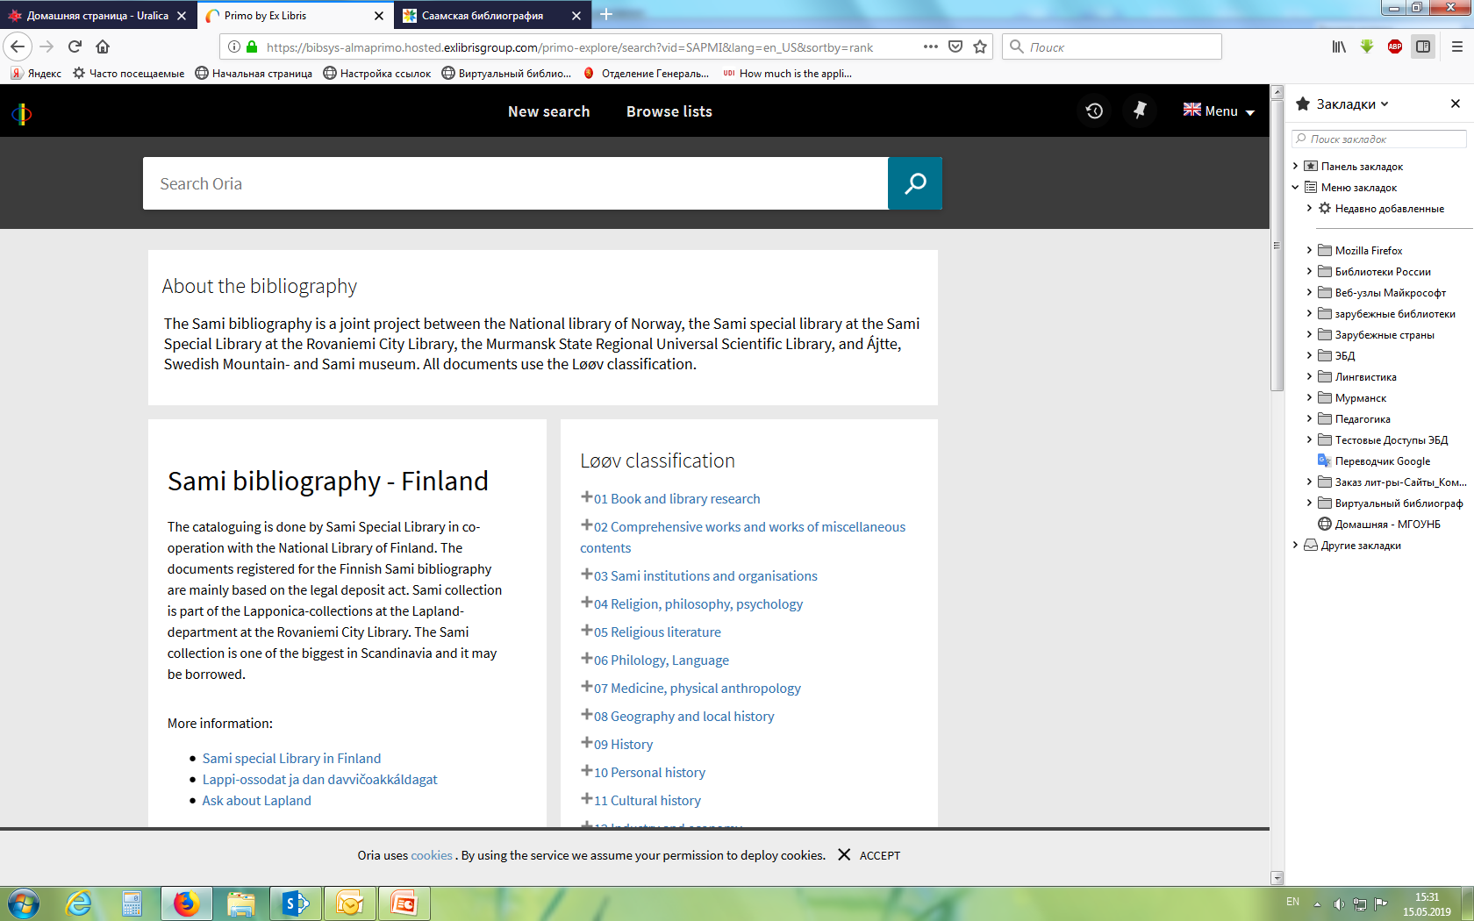
«Joint Sámi Bibliography»

Slide 4
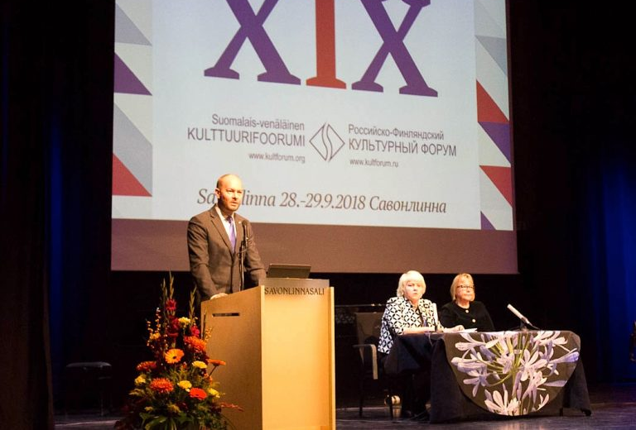
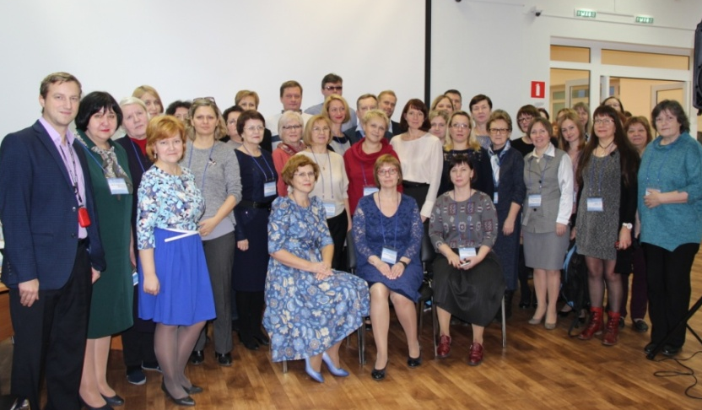
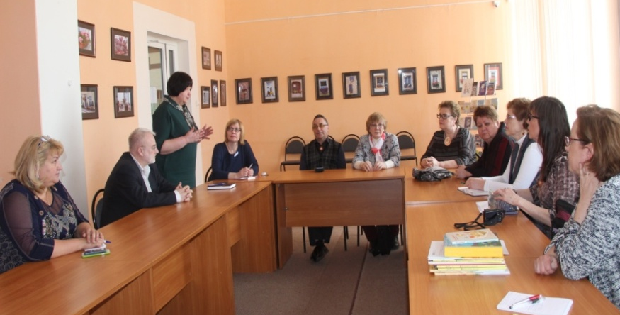
FINNISH-RUSSIAN
CULTURAL
FORUM
2018
INTERNATIONAL
LIBRARY
CONFERENCE
2018
VISIT OF
FINNISH
COLLEAGUES
2019

Slide 5
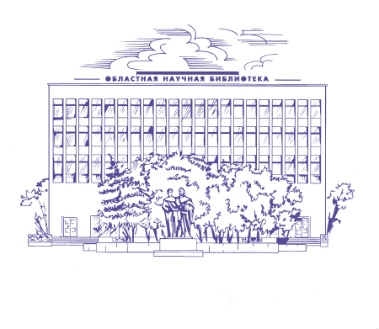
PROSPECTS
BOOK EXCHANGE - MURMANSK SCIENTIFIC LIBRARY AND ROVANIEMI CITY LIBRARY
PROJECT
«BARENTS
LIBRARY
SCHOOL»

Slide 6
THANK YOU FOR ATTENTION!
KIITOS!
Kochergina Lyubov
LIBRARY SERVICE DEPARTMENT
Murmansk state regional universal scientific library
E-mail: ino@mgounb.ru
Тel. 8 (815-2) 45-63-25

