Slide 4
Notes:
13 ships design companies
14 shipyards
170 maritime equipment supliers
20 shipping companies – 18.000 people - USD 7 billion

Slide 8
Notes:
Breivik Fish Processing Equipment – filleting, headcutting and skinning systems
Fiskerstrand Yard - 20 years of experience with Russian fishing fleet – repair and conversion
Triplex – Deck macinery - specialized cranes

Slide 9
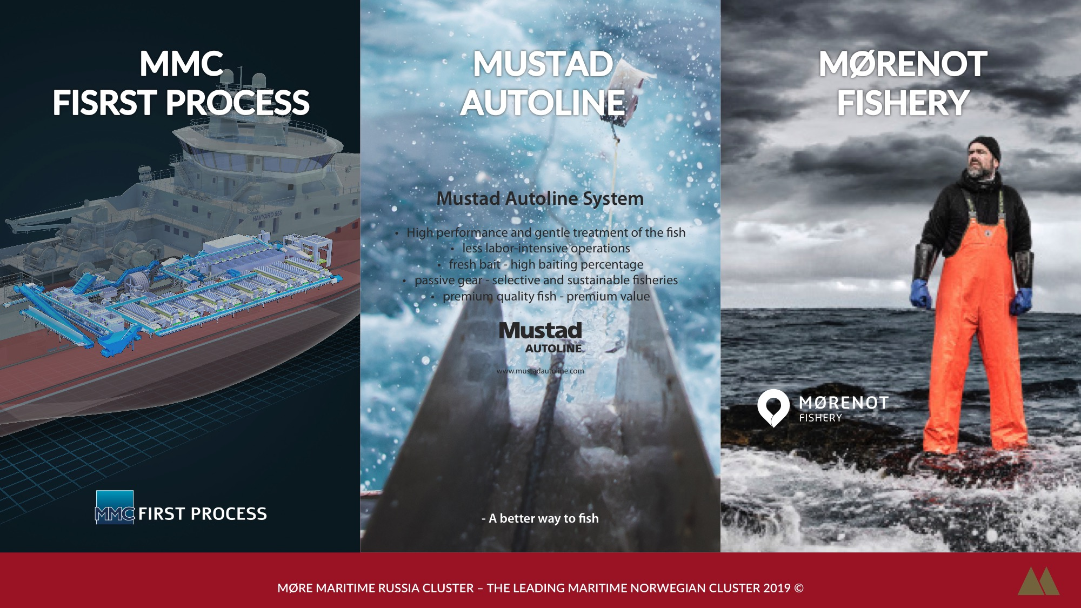
Notes:
MMC – fish handling – processing and freezing equipment
Mustad Autoline System – automated longline fishing –Mustad hook
Mørenot Fishery – world wide supplier of trawls, lines and pots

Slide 10
Notes:
Norwegian University of Science and Technology – Close cooperation with the maritime cluster in Møre R&D with universities in SPb and Arkhangelsk
Optimar – fish handling system – freezing, palletizing and conveyor lines
Rapp MacGregor global supplier of electric and hydraulic deck machinery

Slide 11
Notes:
Seaonics: integrated handling systems of deck machinery and control systems
Teknotherm: leading supplier of refrigeration systems –freezing and cooling technology
NRCC in this respect - we are creating networking arenas focus on B2B discussion industrial marketing

Slide 14
